Slide 1
PREDICTIVE MODELS FOR HOUSING PRICES IN AMES, IOWA
STAT 515 - FINAL PROJECT
Group 7: Huong Dang
Japneet Kohli
Zulay Melendez Valle
Shalini Nambiar

Slide 2
Contents
Dataset Description & Objective
Data Exploration & Preprocessing
Predictive Models
Decision Tree
Random Forest
Linear Regression
Model Comparison
Challenges
Limitations and Next Steps

Slide 3


Dataset Description
Ames Housing Dataset
Obtained from Kaggle
Compiled by Dean De Cock (2011)
Dataset
1460 observations
80 variables
The response: SalePrice
Predictors: describe building properties, space, location
34 numerical
45 categorical (nominal & ordinal)

Slide 4

Project Objective
Good predictive model for housing prices in Ames, Iowa
Best predictive variables

Slide 5
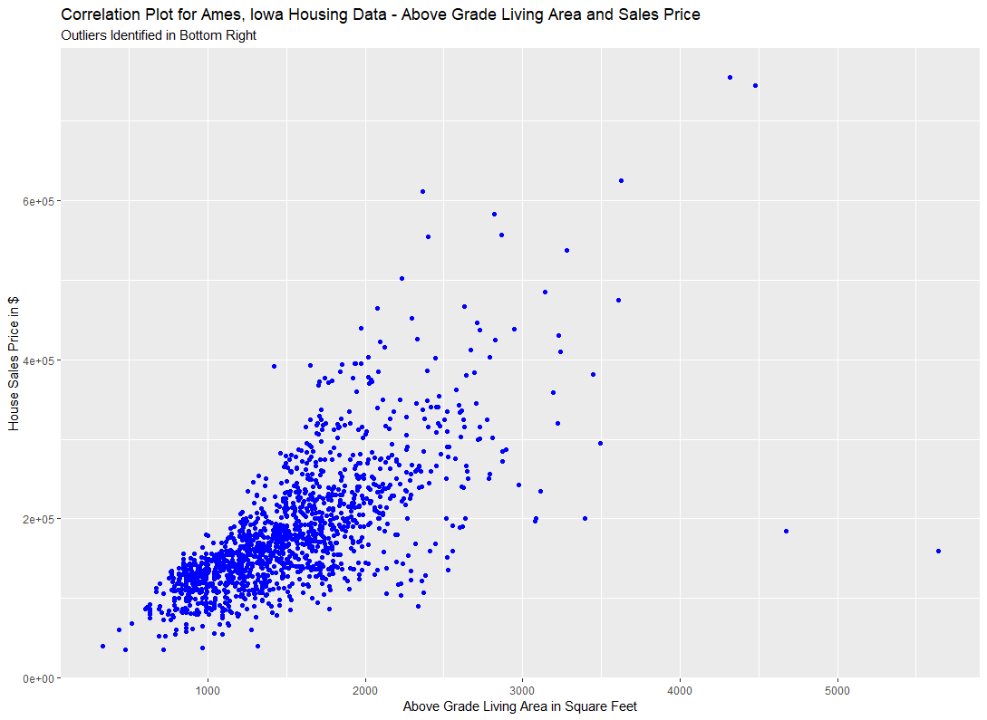
Data Exploration & Preprocessing
Variables containing “NA” value
Stood for “Not Applicable”, not missing values
Categorical variables: convert as additional level
Numerical variables: covert as zero
4 variables containing > 80% “Not Applicable” value
Removed from the analysis
2 observations appeared to be outliers
Removed from the analysis

Slide 6
Data Exploration & Preprocessing
Numerical variables
Year the property was built
Year the garage was built
Year the remodeling was done
Transform them into age data to create 3 new variables
Remove the old variables
Ordinal variables
Converted to numerical form
Applicable to use Principal Component Analysis (PCA) for dimension reduction
All numerical variables
Scaled to avoid large-range variables overshadow low-range variables

Slide 7
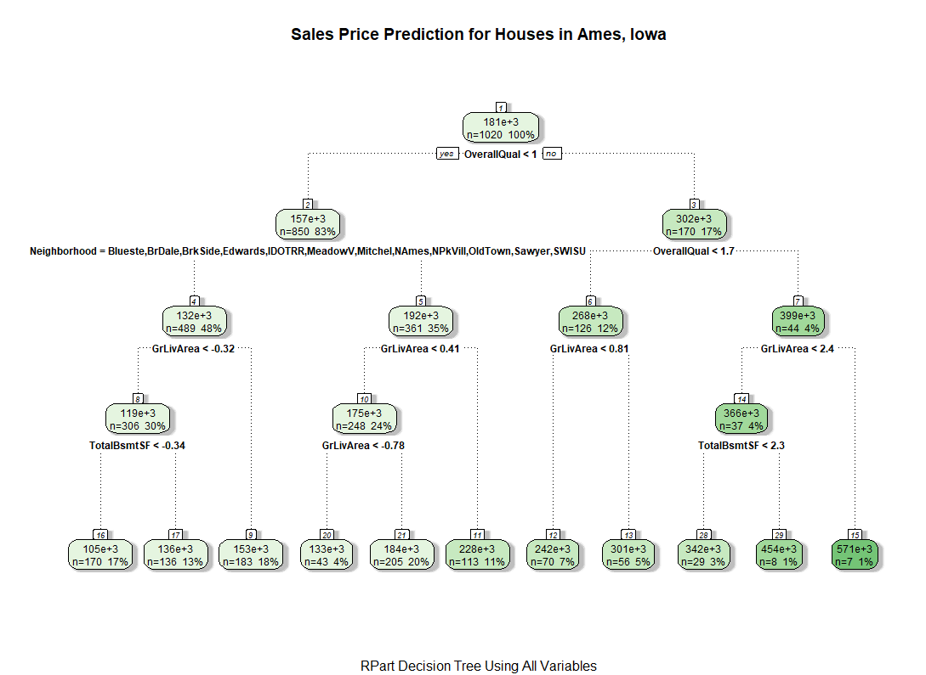
Regression Tree Model
Decision Tree With All Variables
Important Variables: Overall Quality and Neighborhood
Root
Mean
Square
Error (RMSE):
$38,134

Slide 8
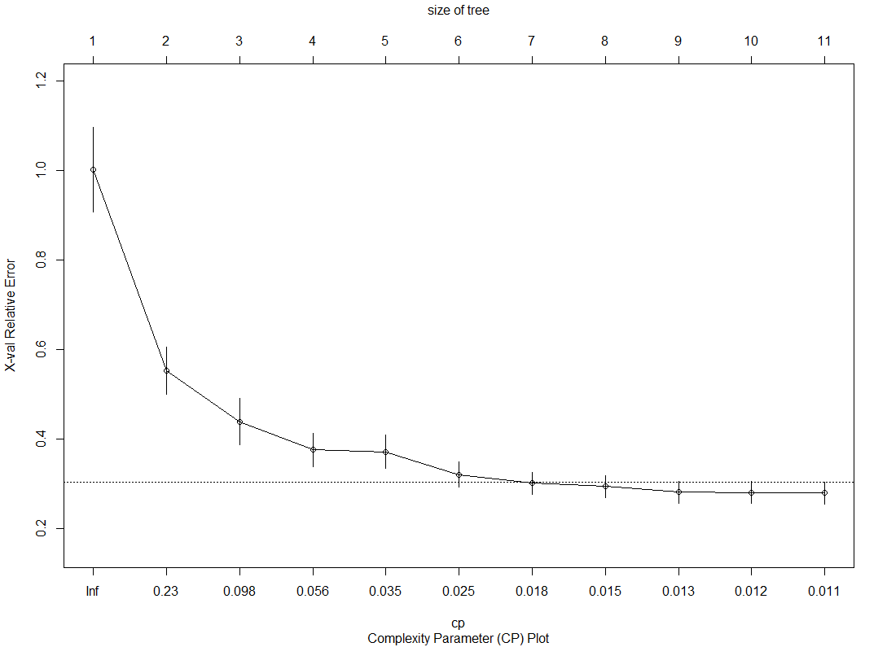
Regression Tree Model
Prune Tree: Complexity Parameter Set to 0 and Plotted
Best Fit: Size 7, Splits 6, cp 0.18

Slide 9
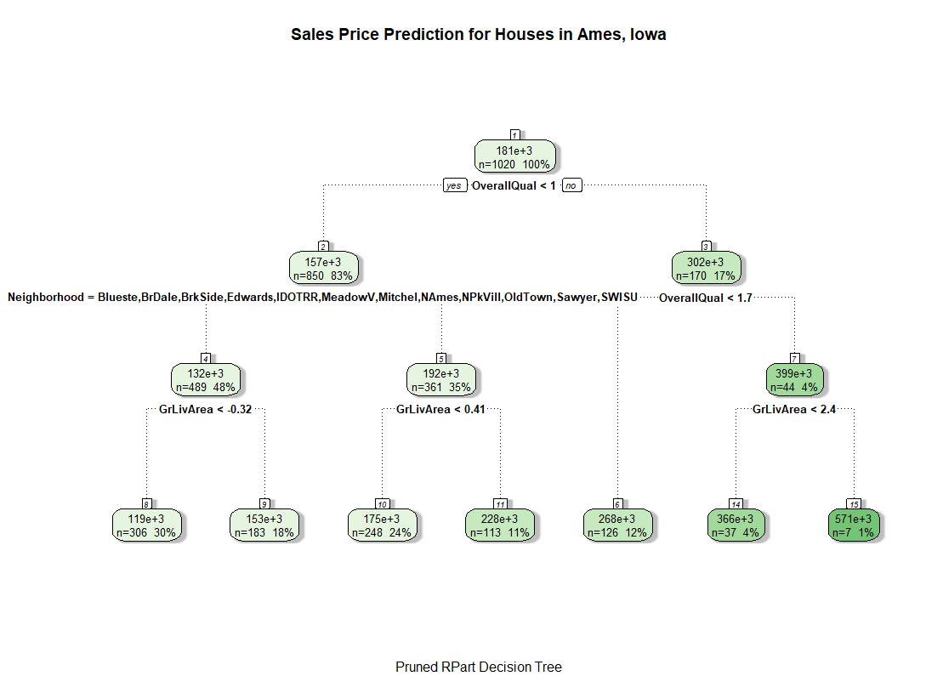
Regression Tree Model
Pruned Decision Tree
Important Variables: Overall Quality and Neighborhood
RMSE: $42,524

Slide 10
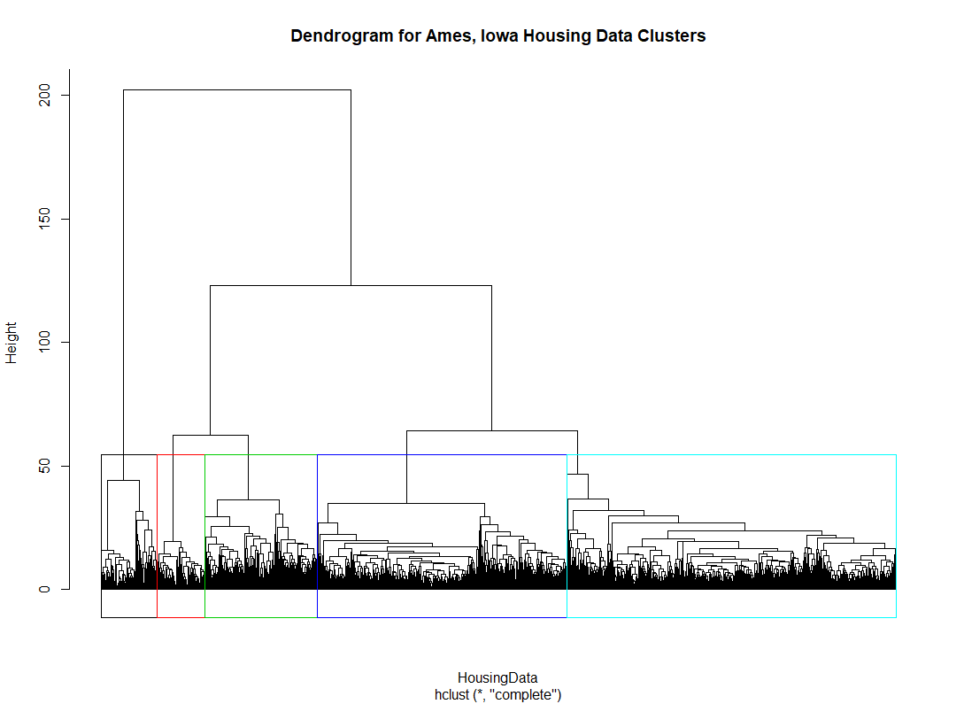
Regression Tree Model
Cluster Analysis of Neighborhood Variable
Neighborhood Categories Had Minority Memberships in Identified Clusters
Hard to Identify Neighborhood Based on Clusters

Slide 11
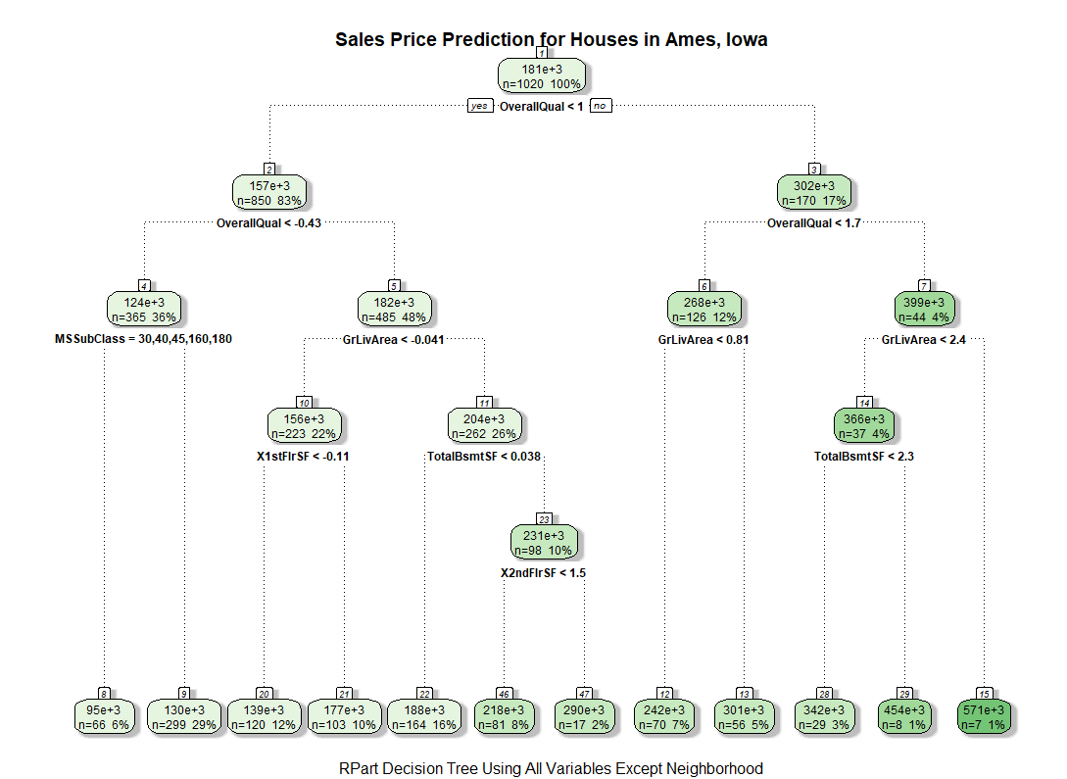
Regression Tree Model
Pruned Decision Tree: Without Neighborhood
Important Variables: Overall Quality, Above Ground Living Area, 1st and 2nd Floor Living Area, Basement
RMSE: $40,721

Slide 12
Random Forest Model
Tried various models with different number of variables at each split (mtry)and different numbers of trees in each forest (ntree).
Root Mean Square Error (RMSE) improved drastically as mtry increased, but did not show much improvement with higher ntree.

Slide 13
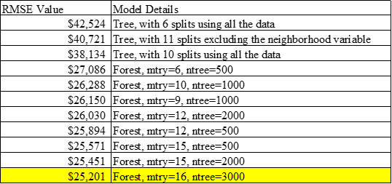
Random Forest Model
Best Model had RMSE of $25,201
Important Variables: Above Ground Living Area, Overall Quality, Garage Area (New)

Slide 14

Linear Regression Model
The dataset is YUGE!!

Slide 15
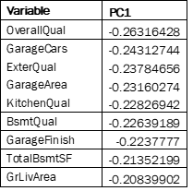
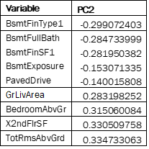
Principal Component Analysis

Slide 16
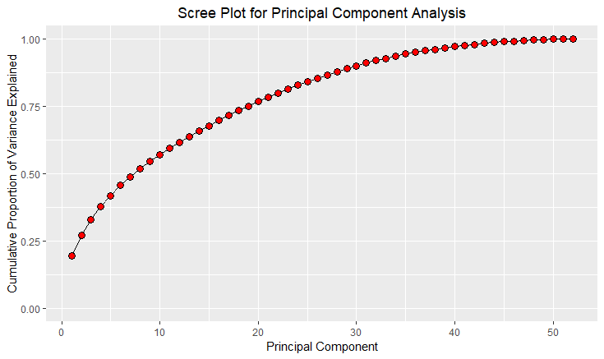
Principal Component Analysis
RMSE - $ 32,986

Slide 17
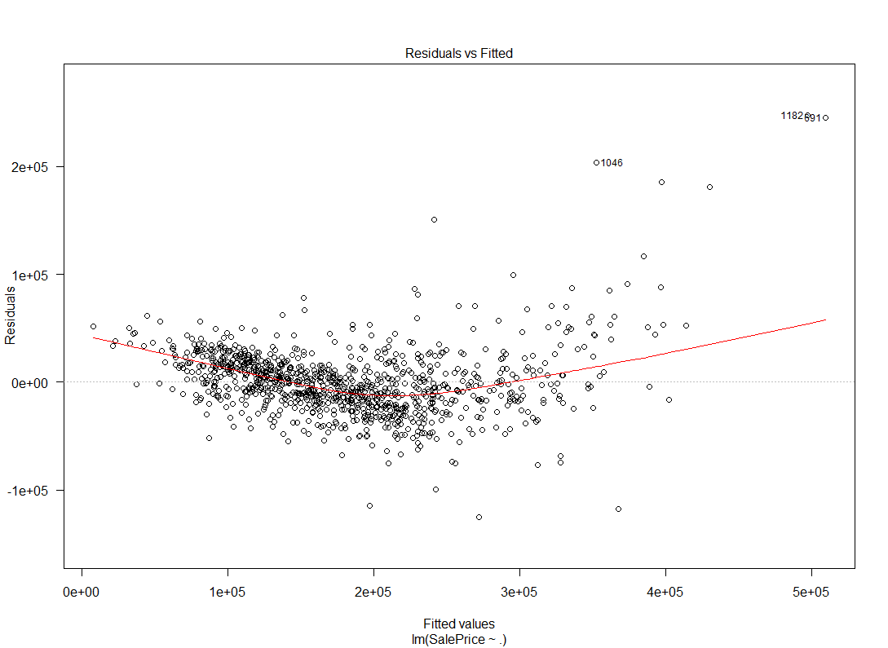
Regression Diagnostics
Testing the Mean and Standard Deviation Assumptions of Error Terms

Slide 18
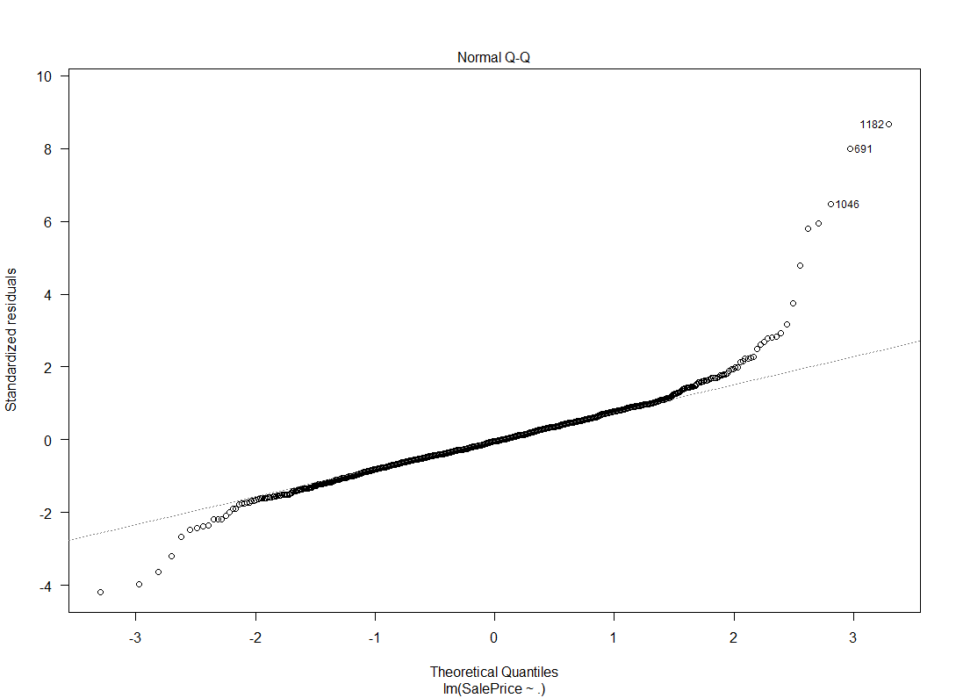
Regression Diagnostics
Testing the Normality of the Error Terms

Slide 19
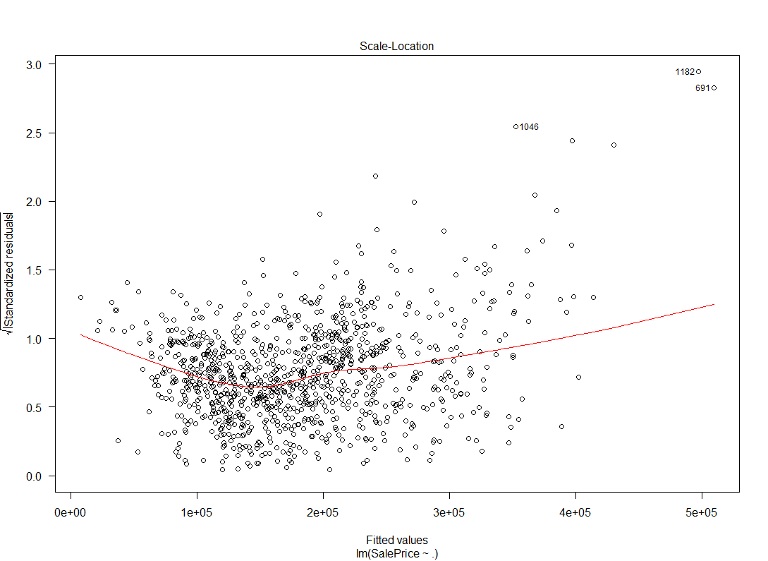
Regression Diagnostics
Testing for Heteroscedasticity

Slide 20
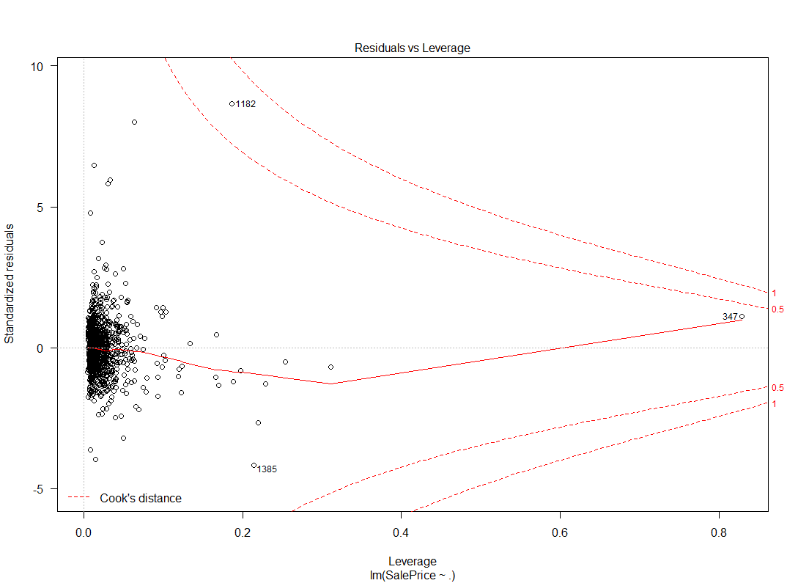
Regression Diagnostics
Testing for Data Points with High Leverage

Slide 21
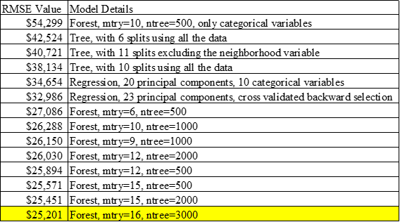
Best Model Fit
Random Forest Model With Lowest RMSE

Slide 22
Challenges
Dataset size (1460 observations and 80 variables)
Number of categorical variables (levels within each)
NA values (Not Applicable)
Clustering neighborhoods in a specific cluster

Slide 23
Limitations
Linear Regression Assumptions Violations
Mean of the Error terms ≠ 0, and
Standard Deviation is not constant } Fitted vs Residual PLot
Normality of the Error } Normal Q-Q plot
Variables with high leverage were found } Residual vs Leverage

Slide 24
What is Next?
Transforming (Skewness and outliers)
Combining Levels: on the categorical variables
Creating new variables
Subsetting the dataset (to create cluster analysis with each subset based on neighborhood)
Subsetting the dataset
Performing a Logistic Regression Model (to predict neighborhood membership)

Slide 25
Thank you!
Questions?

